Slide 1



Movie-Genre-Multi-Label-Text-Classification
Machine Learning and Deep Learning (650.025, 22W)
Project PRESENTATION
12231704 Mustafa Tahİr Bİngöl
12237686 Mustafa Tayyİp BAYRAM

Slide 2
Agenda
Learning Task
Types of Classification
Mutli-label Classification Applications
Performance Measure
Preliminary Data Analysis
Literature Overview
ML Approach
Data Preprocessing
Modelling
Results

Slide 3
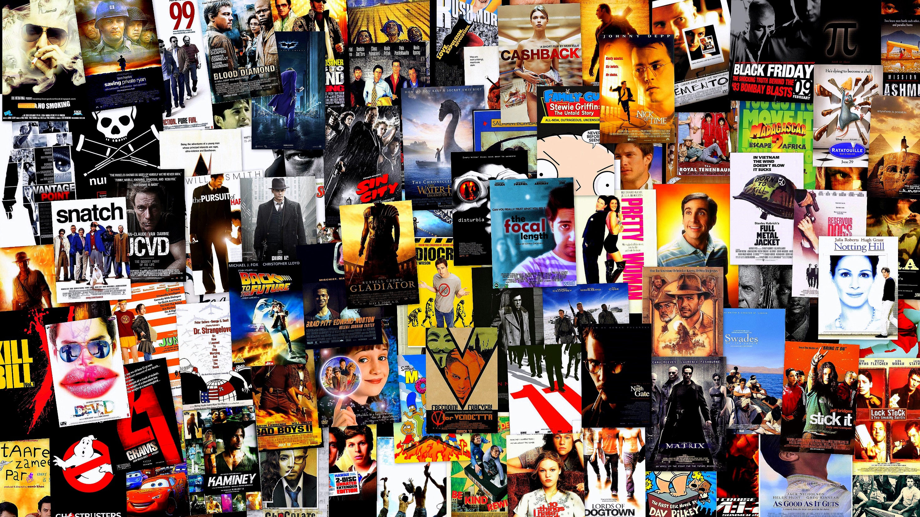
Learnıng Task
Multi-label movie genre classification using movie plot data.
Classification Tasks
This Photo by Unknown Author is licensed under CC BY-SA-NC

Slide 4

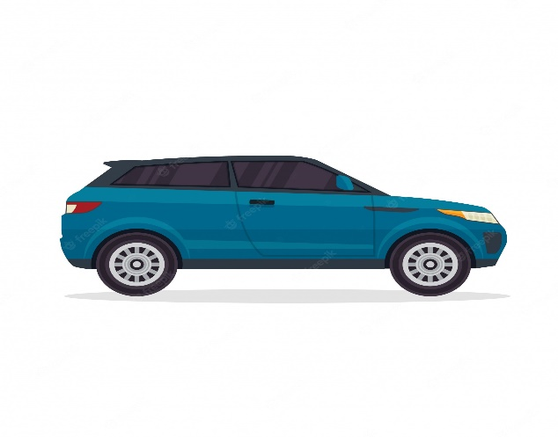

Types of Classıfıcatıon
Bınary
Multıclass
Multı-label
Fradulent or Not Fradulent
Car or Bike or Bus or Ship
Crime, Drama, Mystery, Comedy, History

Slide 5
Mutlı-label Classıfıcatıon Applıcatıons
Image/Text/Musıc Classıfıcatıon
Bioinformatics
Recommender systems

Slide 6
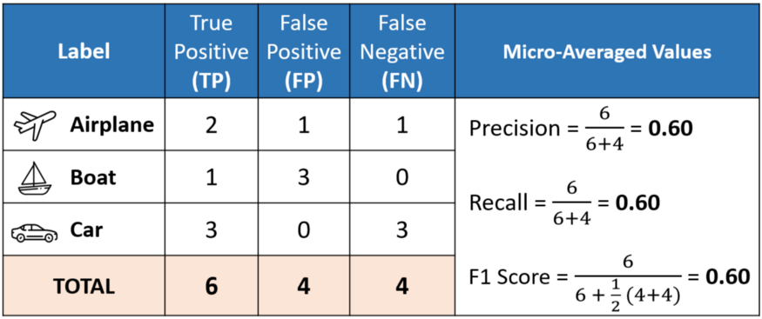
Performance Measure
MICRO F1 SCORE
Global metric calculation for class imbalance.
Used for models where accuracy is key and label positivity is similar.
F1-score computes label avg, micro F1 computes global avg.

Slide 7
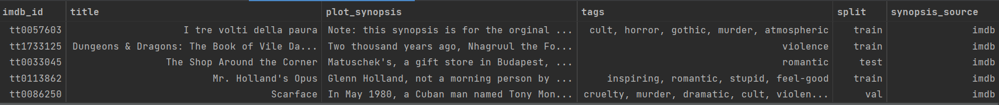
PrelImınary Data Analysıs
Obtained from {MPST}: A Corpus of Movie Plot Synopses with Tags
Sources are IMBD and Wikipedia
Number of plot data = 14828
Columns
imdb_id
title
plot_synopsis
tags
split
synopsis_source

Slide 8
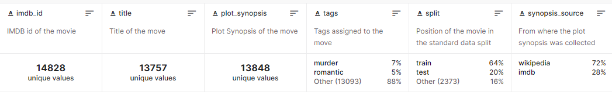
PrelImınary Data Analysıs contd.

Slide 9
Lıterature
MULTIPLE SIMILAR NLP PROJECT.
1 DIRECTLY BENEFITED PROJECT.
Logistic Regression
Naive Bayes
Neural Networks
MANY PROJECTS THAT MAKE USE OF VISUALIZATIONS.

Slide 10
Data PreProcessıng
Remove HTML Tags
Remove Accented Characters
Remove Punctuations
Remove Characters Not In The Alphabet
Convert It Lowercase
Stemming
Remove Stop Words

Slide 11
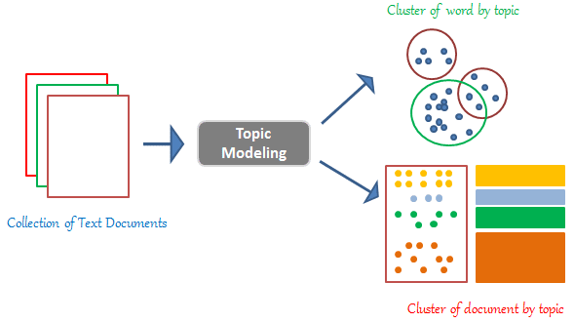
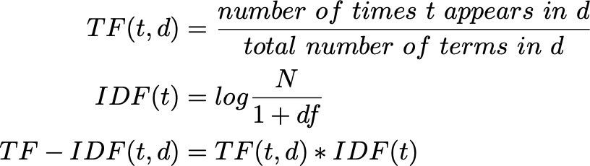
Modellıng Text Featurization (vectorization)
TF-IDF
Topic Modelling – LDA (Latent Dirichlet Allocation)

Slide 12
MODELING CONTD. One-vs-rest approach used in based models
Naive Bayes
Logistic Regression on TF-IDF
Logistic Regression on TF-IDF + LDA

Slide 13
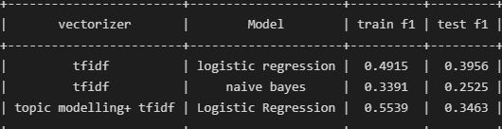
Results

Slide 14

Thank you for listening We want you to be positive in your polarity

